Slide 1
Courier Training
[Trainer and organisation details here]
Notes:
Note to the trainer/developer: This PowerPoint presentation is part of the Courier Training Framework: a tool for developing and delivering courier training. It has been put together as a basis for promoting best practice in the museum and gallery sector. This idea arose from the inaugural meeting of the European Registrar Groups in 2015 and has since been developed within input from sector specialists and professional registrar bodies across the world. The slides and notes fields are fully editable, so they can be tailored depending on the audience. We recommend that you read the Courier Training Framework which provides suggestions for how to develop your training, and recommendations on what to include. The presentation is designed to match the sections of the Courier Manual (part of the toolkit) so that you can ask trainees to follow along and make notes if you have provided them with a copy. The above note can be deleted once read.
Introductions (introduce trainers and ask trainees to introduce themselves). Depending on group size, you may want to ask trainees to indicate their level of experience with couriering.

Slide 2
What will we cover?
Setting the scene
What is a courier and why do we send one?
Preparing the courier
Preparing the loan
How to read the condition report
The journey...
At the venue
Working with incoming couriers
Being a virtual courier
Dealing with the unexpected
From courier training to trained courier
Courier dos and don’ts
Courier Essentials

Slide 3

Opportunities for hands-on learning
Notes:
Optional slide: use to outline any activities the trainees will take part in during the training, as available.
E.g. Checking a condition report, packing a work, trying fittings.
This can also be built into slides 2 and/or 4 as required.

Slide 4
Schedule for the day
Introduction
Courier manual Sections 1 – 5
Break
Courier manual Sections 6 – 12
Lunch
Scenario discussion
Feedback
Summary and close
Notes:
Example schedule

Slide 5
Key aims and outcomes
Understanding core aspects of couriering
Establishing a shared professional standard
      technical skills and processes
      outlining aptitudes
Notes:
This training is designed to give a guided tour of the role and reality of a courier. We will cover how to prepare, what to expect, the different types of journey, the duties and the responsibilities, plus what to do when the unexpected happens.
The training will be broken into information which will be delivered to you, as well as more practical hands-on learning. We will also cover some potential courier trip scenarios and will ask you to consider in groups how you might apply what you have learned to ascertain ‘What should the courier do?’

Slide 6
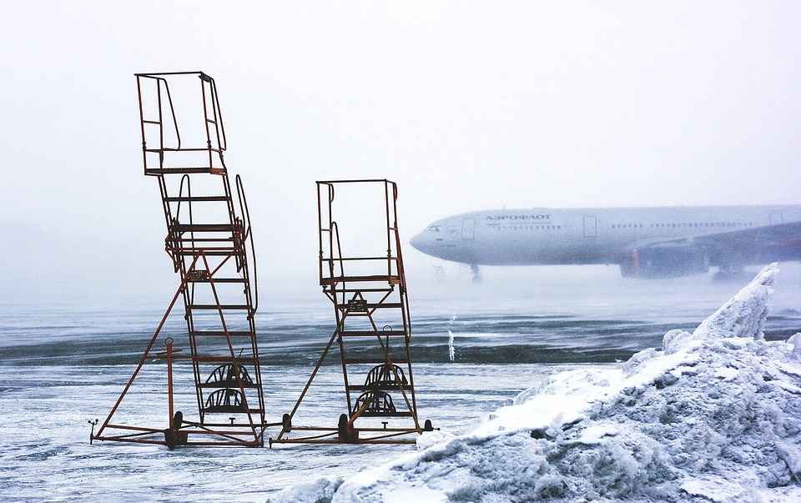
Ice-breaker
Notes:
We suggest beginning with an Ice-breaker activity / scenario question.
You could ask trainees to work in pairs to discuss a scenario from the examples document (part of the toolkit), or you could ask trainees to discuss in pairs a situation where they have undertaken or hosted a courier trip that did not go according to plan. In this case you may want to ensure that trainees with no prior experience are not paired together.

Slide 7

Section 1: Setting the Scene

Slide 8

Managing Expectations
Notes:
The joy of couriering
Couriering brings many positive opportunities. Some of the benefits of being a courier are; networking, travel, working ‘hands-on’ with the collection, and it provides opportunities for growth and working outside your usual remit.
The reality of couriering
Although couriering can be joyful, many trips also involve long journeys, often by motorway or with large amounts of time spent in industrial cargo sheds or loading bays. Although travel is involved you may be limited as to the time spent in the destination. Situations may occur which push you outside of your professional comfort zone, or that test your patience. You may experience jet-lag and tiredness and the journey can be strenuous so if you have a concern that you may not be able to manage this, please discuss this with your registrar.

Slide 9
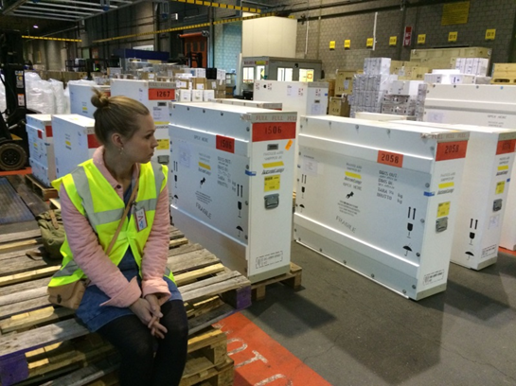
Section 2: What is a courier and why do we send one?
Credit: Wendela Brouwer
Notes:
One way of kick starting this discussion is to ask trainees to do quick exercise, to write down three things a courier is, and three thing a courier is not. Give them 60 seconds and then collect and discuss all the responses. Themes of good and bad practice can then be drawn out.

Slide 10
What is a courier?
Accompanying object?
Supervising road/air transit?
Installation?
Part of a team at the borrowing venue
Representing the lending organisation
The courier is both guardian and decision-maker in regards to the best interest of the object.
Notes:
Depending on the type of journey you are undertaking, it could be that you are required at installation only, or alternatively you could be accompanying an object ‘nail-to-nail’ so from point of packing until it is on the wall at the host venue.
It is the responsibility of the courier to do their best to ensure that the object is safely loaned. Their responsibility can involve accompanying, supervising or directly handling the loan object, as part of the chain of custody. The courier is often therefore both guardian and decision-maker in regards to the best interests of the object (bearing in mind they may need to refer to base for some decisions). They must be also be aware of expertise and vested interest of others involved in the process (agent and borrower) and work as part of a team to find appropriate solutions to any issues that arise.
The courier is expected to be familiar with the object being lent and to undertake the condition check and installation along with the host venue team. Sometimes this means supervising installation, but in certain cases they are expected to lead install, or to handle or assemble objects where appropriate.
The courier is representing the organisation at all times, but normally at the borrowing venue’s cost (which is often a significant amount therefore is it vital to both understand and fulfil the requirements of the role of courier).

Slide 11
Why do we send a courier?
Risk to the loan
Risk to the environment
Finding a balance
Notes:
Why do we send a courier?
Risk to the loan
Think about the specific risks that an object might encounter during a loan. Many of these can be mitigated by good communication between the lender and borrower in preparing for the loan. It is the responsibility of the courier to do their best to ensure that the object is safely loaned. Their responsibility can involve accompanying, supervising or directly handling the loan object, as part of the chain of custody. The courier is often therefore both guardian and decision-maker in regards to the best interests of the object (bearing in mind they may need to refer to base for some decisions). They must also be aware of expertise and vested interest of others involved in the process (agent and borrower) and work as part of a team to find appropriate solutions to any issues that arise.
The courier is expected to be familiar with the object being lent and to undertake the condition check and installation along with the host venue team. Sometimes this means supervising installation, but in certain cases they are expected to lead install, or to handle or assemble objects where appropriate.
The courier is representing the organisation at all times, but normally at the borrowing venue’s cost (which is often a significant amount therefore it is vital to both understand and fulfil the requirements of the role of courier). The purpose of the courier’s role can differ in terms of the practical tasks, but they are always at the apex of the relationship between lender and borrower, often witnessing that contractual obligations (from both sides) are fulfilled.
Risk to the environment
Environmental impact is not limited just to the courier trip itself but concerns the whole arena of lending and borrowing from what we say in our loan policies, to packing and crating specifications, transport requirements, as well as hotels and more.
Finding a balance
The decision to send a courier can have a big financial impact for the host venue, but also impacts on the resources of both institutions. Deciding when, and when not, to send a courier is a fine balance.
If we, for example, are more concerned with the loading processes at the airport than the installation at the venue, may we send a courier to load the crate at the local airport and ask the borrower to send a courier to supervise the unloading at the destination?

Slide 12
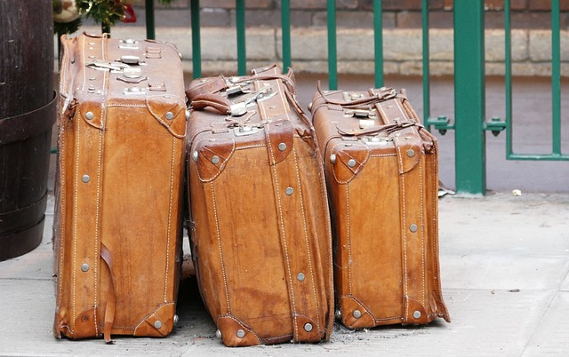
Section 3: Preparing the courier
Notes:
Image free from Pixabay

Slide 13
What is arranged for you?
Itinerary (trip, objects involved, venue, agreed conditions of loan and useful contacts).
mode of travel
per diem
hotel
travel insurance
guidance regarding VISA (where necessary)
Notes:
What is arranged for you?
An itinerary is normally provided by your Registrar (working with host venue), giving details of the planned trip, objects involved, venue, agreed conditions of loan (i.e. how and where you will install at the venue) and useful contacts. Your travel, per diem, hotel, and travel insurance are normally provided, along with guidance in obtaining a VISA where necessary. Business class travel is usually provided for any long-haul flight where you are travelling with objects (on a passenger flight), and economy at all other times. Note there is no differentiation in class on a cargo freighter, and rail travel is likely to be assessed on a case-by-case basis.

Slide 14
What do you need to arrange?
Passport (in date)?
Travel documents (VISA etc)
Inoculations
Check that you understand the route and all aspects of your transit.
Local currency for personal use / arrival arrangements
Route from your hotel to the venue
Means of communication ( have you enabled roaming for the area you will be visiting)?
Destination climate vs cargo shed/depots (practical footwear and warm clothing)
Is you luggage and contents compatible with all airline restrictions?
Notes:
Ensure your passport and any other travel documents are up to date, and check and confirm if you need additional inoculations for travel, or other healthcare certificates (e.g. testing for Covid-19), or other requirements (these may be covered by your institution – you will need to check). Check for any healthcare measures and local rules. Do you need to take masks?
Check that you understand the route and all aspects of your transit. You may need small amount of local currency for personal use or for arrival arrangements (especially where the per diem is paid at the venue) your Registrar should discuss this with you but it is always worth scoping in advance. It is strongly recommended to have a credit card that works in the destination country. Check the route from your hotel to the venue and how much time you will need to get there for your installation appointment.
Ensure you have a means of communication (e.g. mobile phone). If working internationally, check that the roaming is enabled for the area you will be visiting.
Research the destination climate and dress appropriately. Remember that cargo sheds and depots you may visit on the way to a hot climate can be very cold, and you are likely to need sensible clothing and practical footwear. Check whether hand luggage or stowed luggage is permitted (a courier with hand luggage is more flexible). Ensure your luggage and its contents are compatible with all airline restrictions.

Slide 15
What paperwork to expect?
Condition report
Courier itinerary
Travel documents
Notes:
What kind of paperwork to expect:
The key documents for the courier:
Condition report: This records the agreed condition of the work upon arrival at the venue and will form a point of reference for condition check upon de-installation and unpacking upon return. The courier will normally be responsible for undertaking a detailed condition check of the loan object (together with the venue) and signing the condition report with the venue. Agreeing the condition of the object at point of delivery (and checking there has been no change since packing at the point of origin) is how the lender and borrower agree who is liable for any damage or loss. Ensure you have familiarised yourself with the object you are lending and if you are working outside your normal remit, ensure you understand all the terminology contained in the condition report.
Section 3: Preparing the courier
Courier itinerary: This is usually provided by the registrar, giving details about the venue, route, staff you will meet (including venue staff and transport agents), accommodation, and per diem (daily subsistence money, normally provided by the venue), as well as the loan requirements you are responsible for.
Travel documents: These are usually provided by the registrar, and likely to include flight tickets, and personal travel insurance (to cover any medical issues or theft of your personal belongings). Note that if there is a theft (of your personal belongings), you are likely to need to inform the local police and obtain a crime number to validate your insurance. Always seek advice from your travel insurance provider at the time this occurs. You may need to arrange private travel insurance if you are extending your trip.
How to read the condition report is covered in more detail in Section 5.

Slide 16
Other paperwork you might encounter
Receipt
Loan agreement
Insurance
Packing report/instructions
Customs paperwork
Remember
Do not sign anything with terms and conditions without checking
Do not sign anything which is presented to you without a translation (anything which you do not understand).
Notes:
Other paperwork you might encounter:
Receipt: This records formal hand-over of object responsibility to the venue. This is normally signed at point of departure from the lender, when handing over to the transport agent (the beginning of the chain of custody), on behalf of the borrowing venue.
Loan agreement: You may be provided with a copy of the loan agreement terms where appropriate.
Insurance: You may be provided with a copy of the insurance which covers the loan of the object where appropriate.
Packing report/instructions: Where necessary, you be provided with or need to generate packing instructions to help clarify how the item is packed (for example if it is a sculpture in a crate with foam inserts, instructions and/or pictures will help ensure the packing is easy to replicate and the order is clear).
Customs paperwork: This will normally be handled directly by your transport agent and customs staff.
If the venue presents you with additional paperwork you were not expecting, check with your Registrar before signing. Do not sign anything with terms and conditions without checking, and do not sign anything which is presented to you without a translation (anything which you do not understand).

Slide 17
Local customs (ways)
Be aware of different cultures and etiquette
Seek advice from other colleagues who have visited the region
Notes:
Section 3: Preparing the courier
Local customs (ways) The region you are visiting may be a different culture to your ‘home’ culture. Although it is not always necessary to adopt the etiquette of the host country, a level of awareness will help couriers to communicate effectively with host teams.
Consider whether the region you are visiting has any customs (ways) or business etiquette that you need to be aware of. Seeking advice from other colleagues who have visited the region can be helpful, but there is also a wealth of information online which can prepare you for what to expect. These can be simple things such as taking business cards when visiting Japan, to more complex issues such as appropriate dress in different cultures. Keep in mind that working patterns/hours can differ depending on things like climate and local culture.

Slide 18
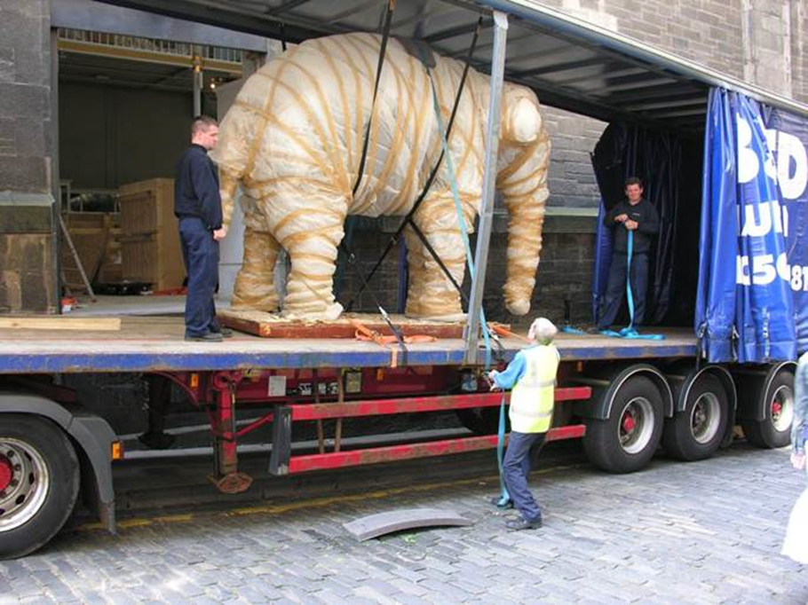
Section 4: Preparing the loan
Credit: National Museums Scotland

Slide 19
When is the courier selected and how?
Identified as part of the loan approval process and agreed after consideration.
Selection criteria:
Does the work require a conservation courier due to its fragility or because there are particular risks that only a conservator familiar with the object can mitigate?
Does the work require specialist installation that only a technician familiar with the work can achieve?
Has the venue borrowed from the organisation before successfully and have we witnessed good standards of object care and installation during past loans?
Is the venue new?
Is there a security or insurance requirement for a courier to accompany the work?
Notes:
All loan requests should be acknowledged upon receipt, circulated to the relevant teams for formal comment, and given formal consideration.
The courier is identified as part of the approval process and depends on the following criteria:
• Does the work require a conservation courier due to its fragility or because there are particular risks that only a conservator familiar with the object can mitigate?
• Does the work require specialist installation that only a technician familiar with the work can achieve?
• Has the venue borrowed from the organisation before successfully and have we witnessed good standards of object care and installation during past loans?
• Is the venue new?
• Is there a security or insurance requirement for a courier to accompany the work?

Slide 20
What preparations are made in advance?
Facilities reports
Environmental data
Display details
Venue access
Sharing cases
Insurance
Selection of transport agent
Notes:
The lender (usually via the registrar) liaises with the borrowing venue, and ensures that preparations are made in advance (facilities reports, environmental data, display details, access, sharing cases, insurance, selection of transport agent etc).

Slide 21
What processes will the loan object go through in advance?
Photography
Condition report
Conservation treatment
Cleaning
Framing or glazing
Mount-making
Inter-site movement
Valuation.
Notes:
The loan objects may go through the following processes: photography, condition report, conservation treatment, cleaning, framing or glazing, mount-making, inter-site movement and valuation.

Slide 22
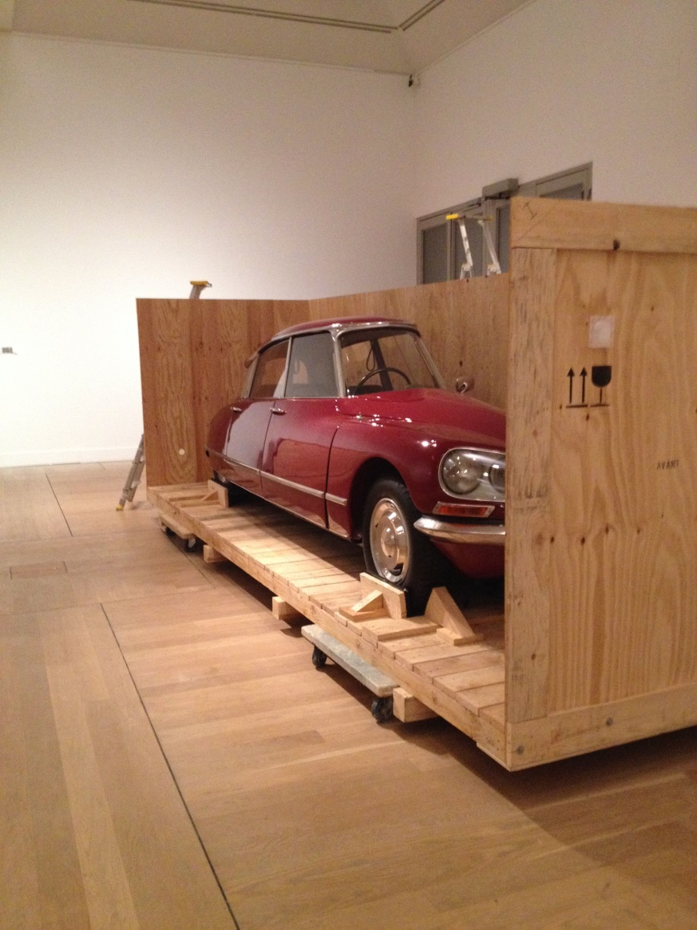
How will the loan be packed?
Credit: Desirée Blomberg
Notes:
Loan objects are packed to minimise the risk of damage in transit. For international loans this usually requires a museum-specification crate, for UK loans a range of packing is used including soft-wrapping, cartons or boxes, transit-frames, etc.
The courier should take the opportunity to familiarise themselves with the object before the journey. They should at minimum arrange to discuss the condition report with the conservator, and the mount or hanging system with the technician. They are likely to be required to help supervise packing of the loan.

Slide 23

Section 5: How to read the condition report?
Notes:
Image free from Pixabay

Slide 24
Condition checking – important steps
Go through the condition report before the object is packed
Upon unpacking, check packing for small losses
Check the object first, and the condition report next
Note all visible damage, including old restorations/repairs
Ensure there is sufficient lighting (raking light)
Note any changes in condition, take photos and ensure that the borrower is aware.
Call your registrar if you note a change in condition.
Ensure the condition report is signed by both parties.
Take a copy/the original as required (so this can be referred to during the loan period as needed).
Notes:
The condition check is a process in which both lender and borrower should be involved. As a result of this check, the current condition of the object is formally agreed and captured by both parties (lender and borrower). Although both parties have a vested interest in this process, it is particularly in the interest of the borrower to record the condition accurately and to flag through this process any undocumented condition issues. This helps to ensure that any pre-existing issues (or those which may have been caused in transit) are noted, agreed and explored as necessary. At de-installation and/or unpacking upon return, the signing of the report captures any change in condition whilst the object was in the care of the borrower, so at this stage it is particularly in the interest of the lender to ensure the condition is checked and recorded.
Condition checking – important steps:
Ensure that you go through the condition report before the object is packed, so you are familiar with any recorded/existing damage or repairs at the outset. You may wish to do this together with the person who wrote the report.
Upon unpacking, it is a good idea to check any packing, such as the bottom of the transit frame, for small losses (such as flakes of gilding from a frame).
When condition checking with the borrower, ensure you check the object first, and the condition report next.
It is important to note all visible damage, including old restorations/repairs.
Make sure that there is sufficient lighting. You may wish to use raking light to check the surface.
Note any changes in condition, take photos and ensure that the borrower is aware. Add a date reference if needed.
Call your registrar if you note a change in condition.
Last but not least, make sure the condition report is signed by both parties. Take a copy/scan or the original as directed by your registrar (note that one copy usually stays with the object so this can be referred to during the loan period as needed).

Slide 25

Section 6: The Journey

Slide 26
Loading onto a fine art transport vehicle
Tail-lift,
Lockable rear portion,
Clean, clear and free of loose cargo
Everything securely tied off using two straps in-case one fails in transit).
Points for tying off cases/objects,
Ties or ratchet straps available.
Air-ride,
Temperature control system (display/control panel that can be read and adjusted in the main driver cab), usually between 18 – 21 degrees centigrade (64-70 degrees Fahrenheit).
Note: If the temperature is not within an acceptable range, check that the system is switched on and the rear doors are closed and ask the drivers to wait a short while until the temperature is within range.
Notes:
As a courier you may be involved in the collection of works, including supervising loading (and checking a truck). You would usually be working with a fine art transport agent using a museum specification vehicle. This should include a suitable tail-lift, lockable rear portion, it should be clean, clear and free of loose cargo (everything should be securely tied off using two straps in-case one fails in transit). The sides of the vehicle should allow suitable points for tying off cases/objects, and suitable ties or ratchet straps should be available. For most objects, the vehicle should be air-ride, and have a temperature control system (with a display/control panel that can be read and adjusted in the main driver cab). Check in advance what temperature range is suitable for the object you are accompanying (when packed), and ask the drivers to confirm that the hold is within that range before loading. If the temperature is not compatible, check that the system is switched on and the rear doors are closed and ask the drivers to wait a short while until the temperature is within an appropriate range.
It is common for the temperature range of the truck to be set at between 18 – 21 degrees centigrade (64 – 70 degrees Fahrenheit). In extreme temperatures it can be difficult to achieve the temperature required with the rear doors open for loading, so work together with the drivers and consult with conservation colleagues as necessary to understand the best strategy for loading.

Slide 27
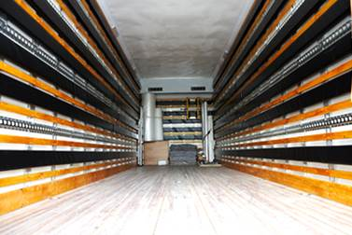
Credit: National Museums Scotland

Slide 28
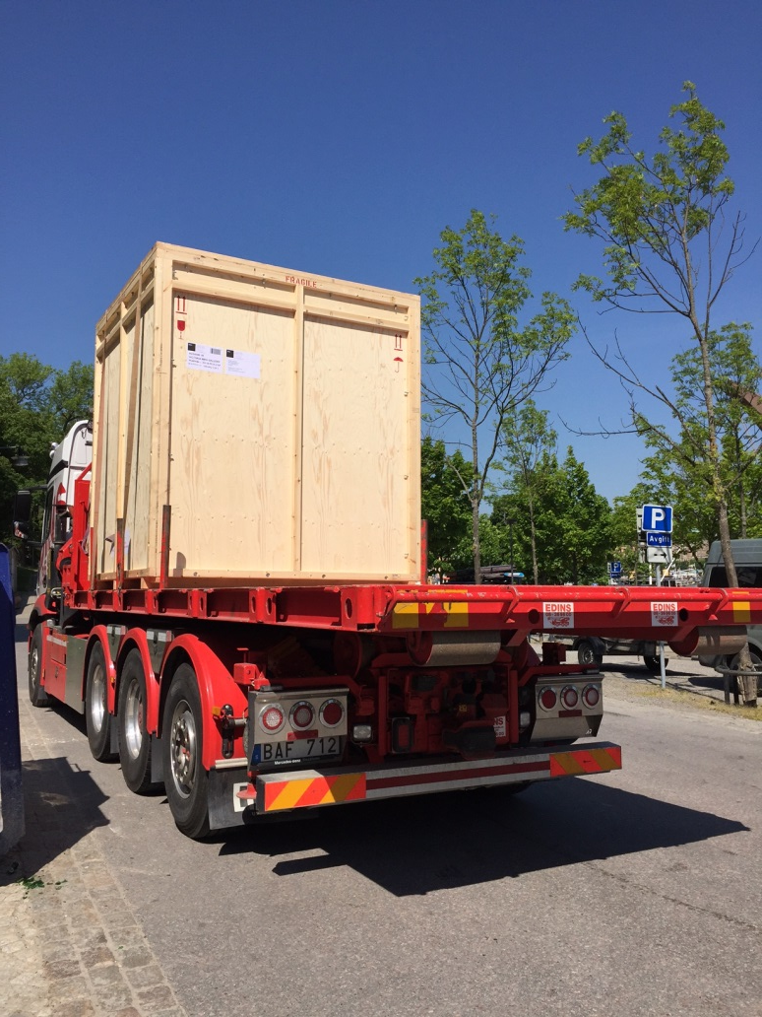
Journey by road
Credit: Desirée Blomberg
Notes:
The majority of courier journeys include a journey by road. During any planned stops for fuel or comfort breaks you should follow a protocol of taking it in turns with the drivers to ensure the vehicle is never left unattended. Journeys can be lengthy so ensure you are prepared for this. Never lock your personal cabin bag in the hold with the cargo during transit (unless you have first removed everything you might need into the cab) as this will prevent you accessing it during the journey due to the security risk.

Slide 29
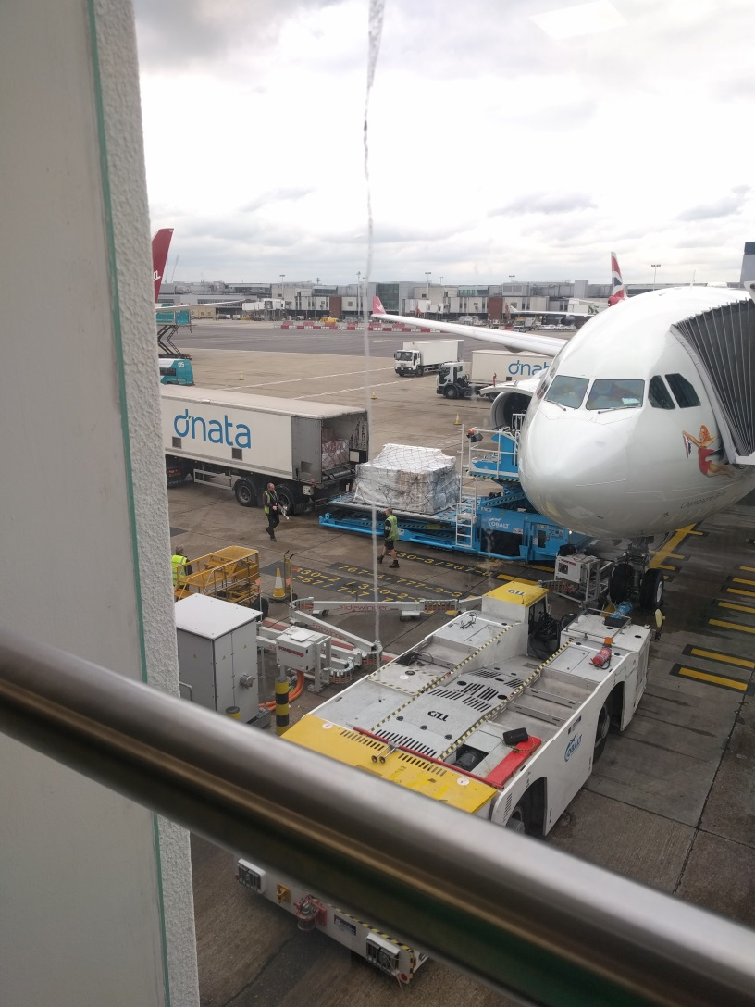
Journey by air
Credit: Flora Fyles
Notes:
As a courier you may experience journeys by air, accompanying objects as cargo via passenger flight.
For journeys via passenger aircraft, the crated objects will be stored under-deck and therefore need to be palletised (the process of securing them in/on an airline pallet). This is done at the airline’s cargo shed and must be completed before lock-out time (approximately 4-6 hours ahead of travel depending on the airline and destination). Ensure you are aware of the appropriate pallet style for your case size and cargo and whether a specific style has been agreed in advance. Some pallets are flat (like a baking tray), whilst some are enclosed or with soft-sides (container).

Slide 30
In the Cargo Shed
Observe access protocols
Do you know what task everyone is responsible for?
Be aware of potential hazards
Follow instructions from the cargo shed staff and agent/supervisor.
Communicate with your agent/supervisor to achieve a good result.
Proximity to pallet will depend on the airline.
Notes:
Upon arrival at the airport, you may need to wait before accessing the cargo shed. You should at this stage be accompanied by an agent/supervisor from your fine art transport agent. There can be one or more people in this role so ensure you understand what task everyone is responsible for. When you enter the cargo shed, be aware of potential hazards, including forklift trucks which can travel at speed, and follow instructions from the cargo shed staff and agent/supervisor.
It is important to realise that you are a guest in this environment, and to be aware that giving direct instructions to the cargo shed staff could be perceived as criticism of their work. Communication often works out better if you discuss adjustments with your agent/supervisor – they are likely to be familiar with the cargo shed team and know how to liaise with them to achieve a good result.
Proximity to pallet will depend on the airline. Sometimes it is possible for direct supervision and some airlines facilitate supervision via direct video-link. Whatever the level of access, you will be working with agent and cargo shed staff to achieve the process of palletisation.

Slide 31
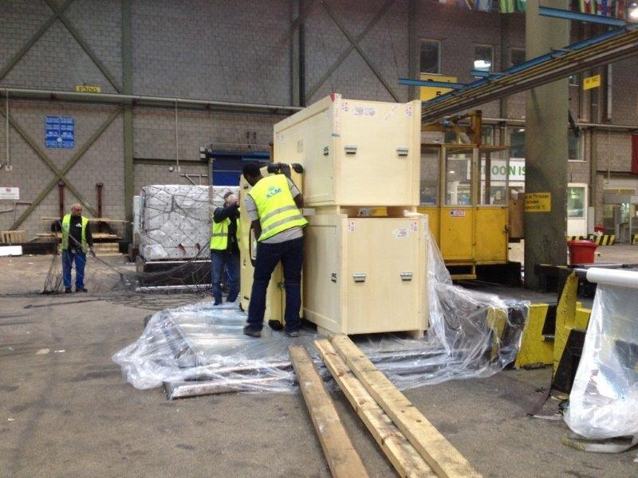
Credit: Wendela Brouwer

Slide 32
Palletisation
Polyethylene (laid on the pallet)
Object cargo (your crate)
Additional cargo (try to achieve box or pyramid formation)
Complete the poly (avoid multiple layers – can cause condensation)
Add ratchet straps (text for tightness but ensure no bowing)
Check there is no movement in any direction
Cargo netting draped (not thrown)
Net tightened with additional straps where required.
Note the pallet number (this should be embossed into the corner outer edge of the pallet).
Notes:
The sequence of the process for a flat pallet is as follows: polyethylene should be laid directly on the pallet first, followed by the object cargo (your crate), additional cargo may be added to the pallet and can be beneficial as this provides a barrier layer, check that any other cargo is inert (no HAZMAT, liquids or perishables), a box or pyramid formation provides good protection with your crate in the centre ideally, complete the poly (but do not apply multiple layers – ‘over-poly’ as this can cause condensation), add ratchet straps and ensure they are sufficiently tight as to prevent movement but ensure no bowing of the pallet – also check there is no movement in any directions), next the cargo netting should be draped (not thrown) across the entire pallet, this is then secured and the net tightened with additional straps where required. During the process, check straps to test the tension and monitor to ensure that the poly layer is not compromised by holes during the process. Once complete, note the pallet number (this should be embossed into the corner outer edge of the pallet). Confirm if you can see pallet loaded on the system and supervise if so, then depart.
Palletising using a container can be more complex. Ensure you discuss with the agent how your crate will be secured within the container, and check that any other material going into the container is also secured to prevent loose cargo rattling against the crate during transit.
Check phone numbers with agent (call to confirm they connect), and agree when and where will they confirm to you that the pallet has been loaded.
At this point the pallet will be making its way through the system, and your level of access means you can no longer accompany it. Supervision is given over to the fine art transport agent who normally has tarmac access and will be able to witness the loading of the pallet onto the cargo deck. The agent normally remains until the cargo deck door has shut in case there is any last minute shuffling of cargo, and will then confirm that you are able to board the plane.

Slide 33
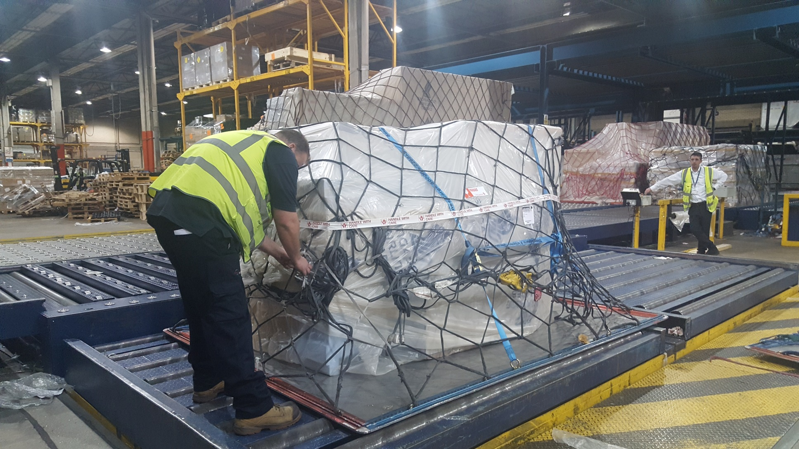
Credit: Helen Parkin

Slide 34
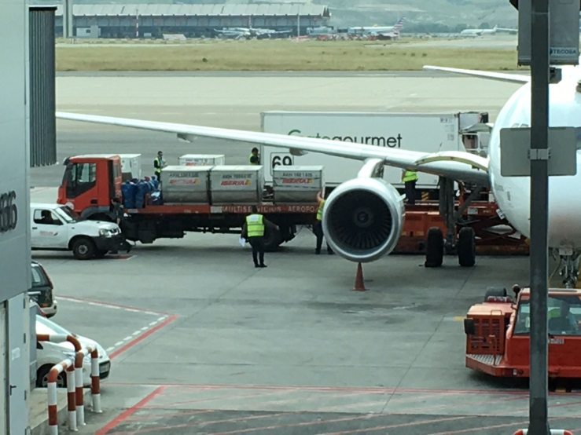
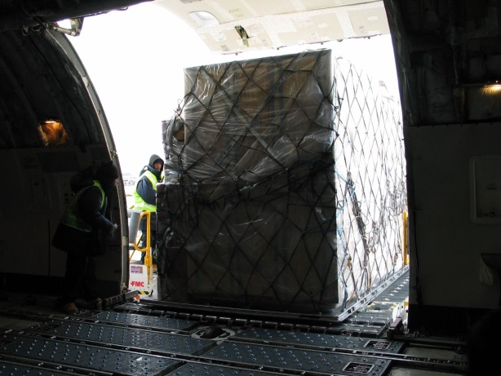
After Palletisation
Do you know when / how the agent will confirm your pallet is loaded?
Complete passengers check-in and security
Await confirmation your pallet is loaded before boarding
Credit: Annika Nelson
Credit: Riitta Rajalin
Notes:
Whilst this is happening, you will be taken to passenger check-in. Following check-in and security checks, you may have access to a lounge depending on your class of travel. Await and monitor your flight’s boarding process, and ensure you go to the gate when directed. Here you are likely to be waiting for some time as you will need confirmation from the agent that your pallet is loaded before you can board. Once your agent has given you confirmation of loading of the pallet you may then board.

Slide 35
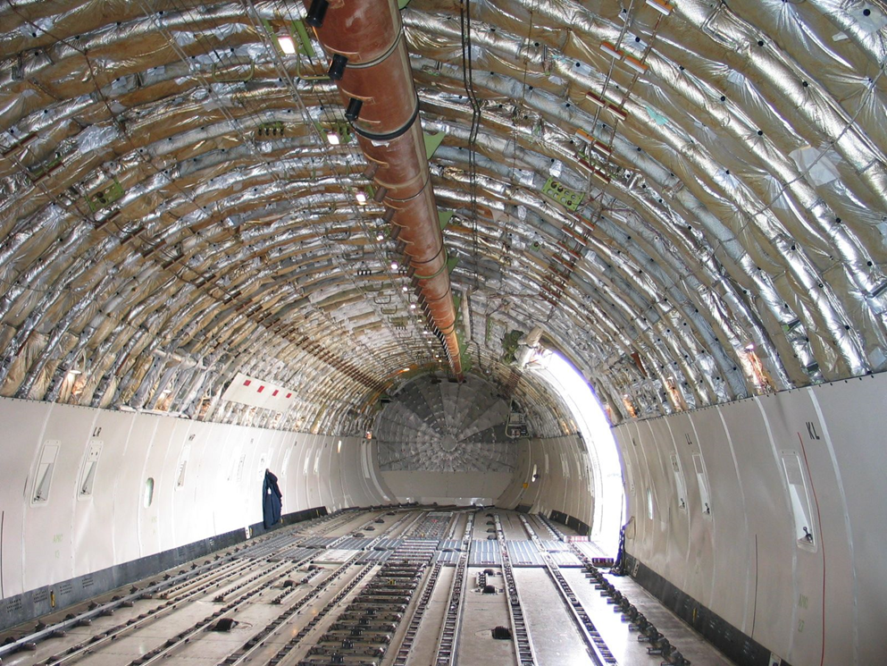
Upper deck / cargo freighter
Credit: Riitta Rajalin
Notes:
If you are accompanying an object by air that is large (normally those crated above 1.6m / 5ft 3 inches in height) then you may experience couriering via cargo freighter. Often referred to as ‘Upper Deck’ the cargo plane involves slightly different processes.
Similar processes are encountered for palletisation, however it is not always true that couriers then depart to the passenger terminal. Couriers travelling cargo may not receive a normal boarding pass, and may be required to complete additional paperwork. Check in advance with your registrar/agent what to expect. Sometimes, boarding takes place directly after palletisation through the cargo terminal and via stairs to the plane which consists of a large deck or belly through which you walk directly to reach a near vertical ladder into the crew area and flight deck. It is often possible to watch your pallet being loaded ‘live’, as access to the deck is not restricted. Always ask what is possible and follow the instructions of the flight crew and cargo staff. The crew is likely to consist of only pilots and no air hostess. Ask which food you may eat as crew food is often reserved and limit interaction with pilots as appropriate (some areas of the flight deck are restricted and only enter the cockpit if invited to do so). When accompanying objects via cargo freighter you may experience delays or occasionally re-routing. Unlike passenger aircraft cargo freighters usually follow a multi-destination route on a large circuit. You may encounter several interim stops, where cargo is exchanged, and multiple take-offs and landings. Some pilots may also interchange at these stops. Once you reach your intended destination, you will be invited to disembark and travel with any pilots leaving the plane to the terminal, normally by small car or bus.

Slide 36
Arrival
Met by agent
Customs and Immigration processes
Remember: Do not declare the cargo (it is not personal goods).
Notes:
Arrival into the terminal:
This is normally the same process for both types of aircraft which involves a customs declaration process, and a passport checking process. You may be met by an agent at the plane door, or sometimes in ‘arrivals’.
When proceeding through customs it is important not to declare the cargo as personal goods (although you are a courier, it is the transport agent who is handling the customs process for the cargo). This will confuse the customs staff and lead to further questioning.
Once you have reached arrivals and met with the agent you will be taken to the cargo shed to supervise de-palletisation. Ask about process and what can be expected. Occasionally someone from the host venue may also be present.

Slide 37
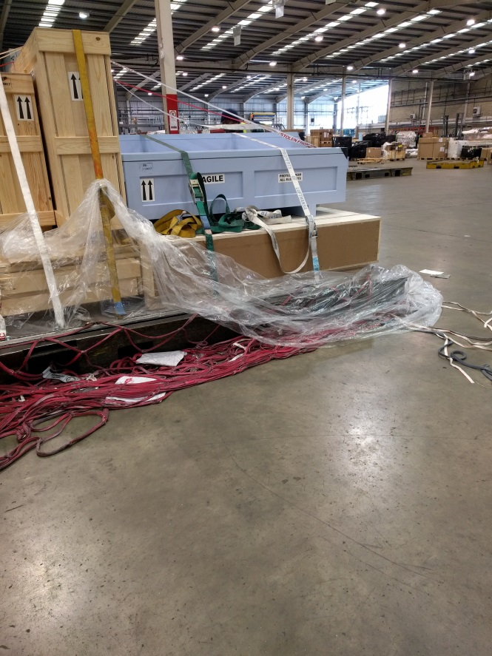
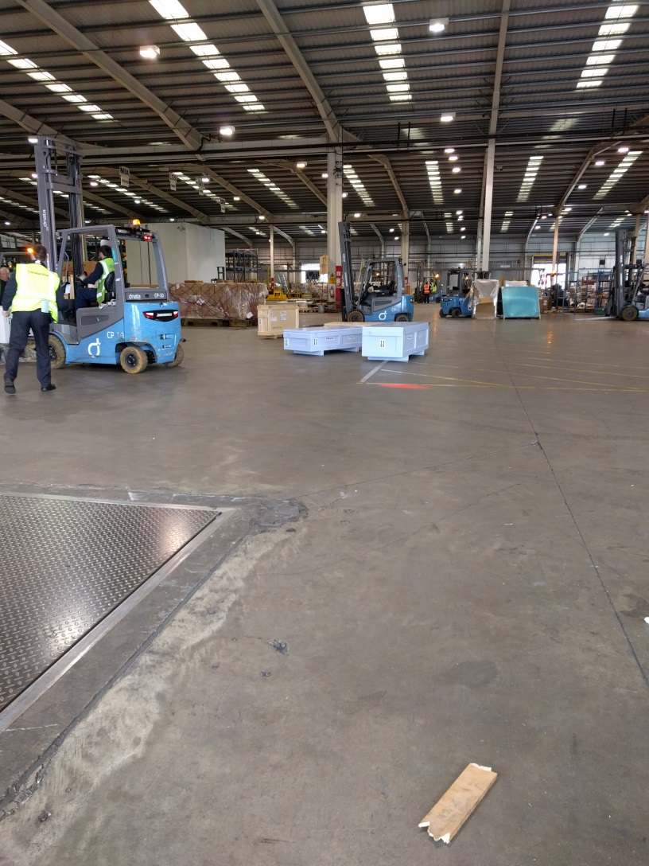
Depalletisation
Credit : Flora Fyles
Notes:
De-palletisation. This is normally a quicker, smoother version of palletisation, however if there is no common/shared language the process can be hard for the courier, especially after a long flight. At this stage you should check over the pallet to ensure there are no visible signs of damage, and also ensure that the vehicle for collection is ready.
The de-palletised crates should be loaded onto the vehicle (remember to check the vehicle is museum specification). Local vehicle styles can vary, so it may be unfamiliar but you need to check whether it is what is expected, and that the temperature control is on and the doors are kept closed as much as possible to maintain the optimum conditions, with other cargo secured. Check that the cargo is secured using at least two straps before you depart.

Slide 38
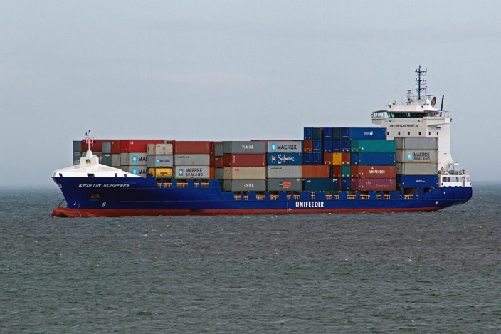
By Sea
Notes:
Sea freight is unusual and due to the restrictions and length of transit, in most cases a courier is not practical or cannot gain access. Sometime port supervision is possible, and it may be possible to arrange for a third party agent to undertake supervision on your behalf. However in cities such as Venice it is possible you may encounter transit via boat as a means of getting the objects to the venue. In such cases your registrar will normally advise you of the procedures on a case-by-case basis.

Slide 39
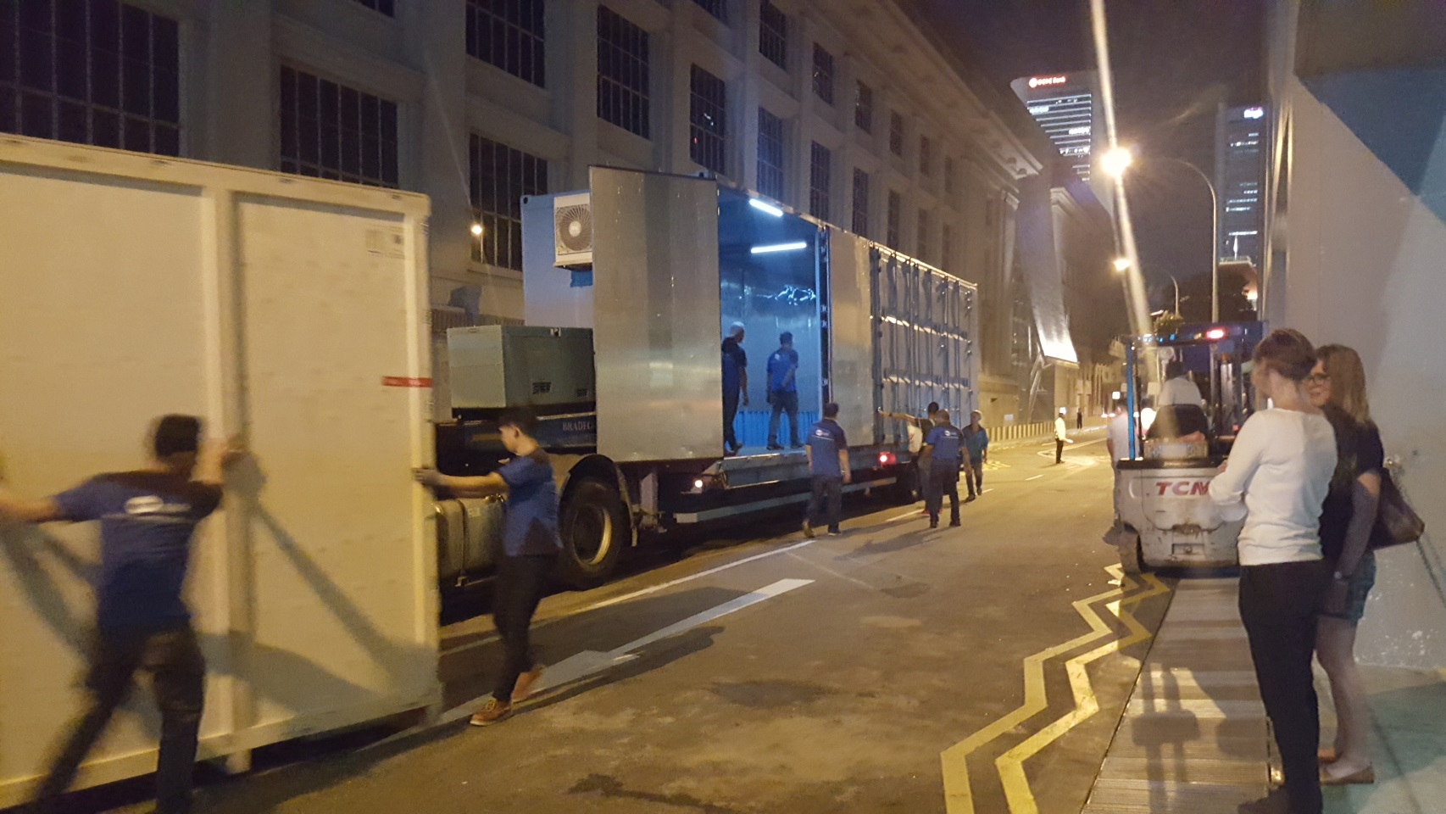
Section 7: At the Venue
Credit: Helen Parkin

Slide 40

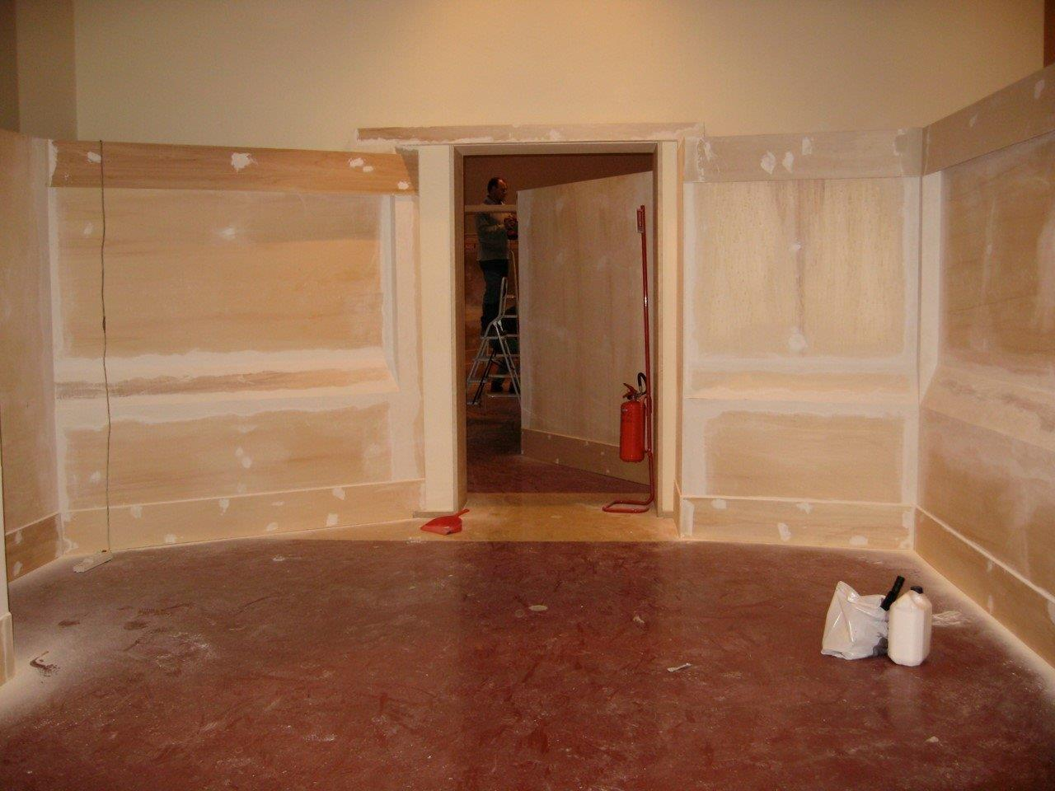
Arrival at the venue
Credit: Wendela Brouwer
Notes:
Upon arrival at the venue unloading should be supervised, along with delivery of the object into the storage or exhibition space. Your registrar will have conducted checks into the standards of security, facilities and environment at the venue. If there is anything specific that they need you to verify upon arrival, they will let you know. If you are not proceeding to install straight away, then the crates should be left in a secure area, and not moved or opened until you are present to supervise this, unless otherwise agreed.
Depending on the length of your journey, you may be moving straight to installation or in the case of international transit you may at this point be retiring to a hotel for a well-earned rest.
If your installation is due to take place later, ensure you are on time for your installation appointment, (this includes not being too early as well as ensuring you are not late). Make sure you have everything you need and you know which entrance to take and who your contact is. Remember that installation often has a very complex schedule with multiple couriers or things that have to happen in sequence. Ensure you respect the given appointment time.
Additional photo available free online at https://stocksnap.io/search/gallery

Slide 41
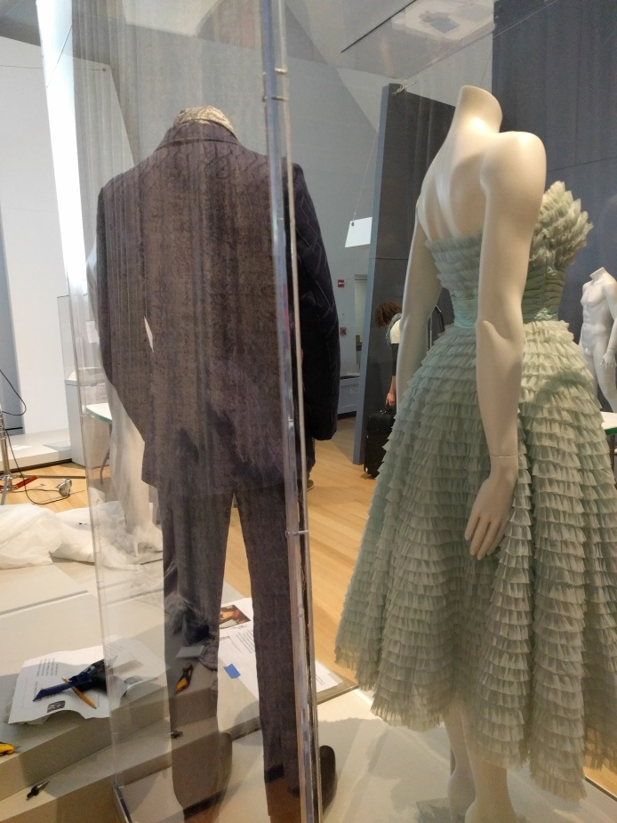
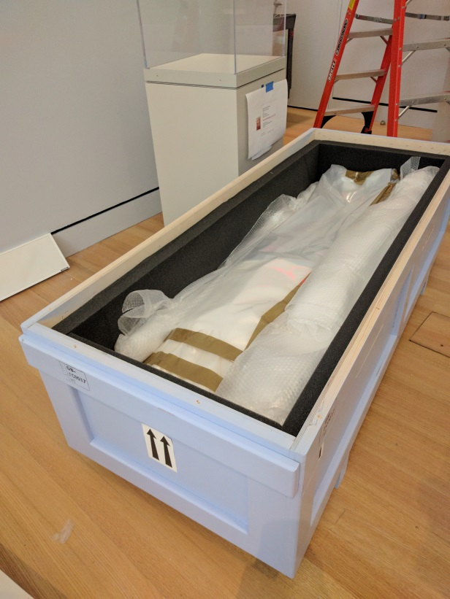
The installation appointment
Credit: Flora Fyles
Notes:
When you are taken into the display area, introduce yourself to everyone you will be working with and ensure you know what roles the people you are meeting will undertake. Being clear about your profession and understanding the expertise of the people you are working with will help. It is easier to work well together if you know whether the staff who are present are art handlers, conservators, curators or registrars.
Normally for unpacking and installation your cases will have remained closed. Before opening, first check where the display area is and if your case can be brought as close as possible to minimise uncrated handling.
Check that the unpacking area is ready (tables set up –lighting in place etc), and that the display area is ready (walls painted and off-gassed, plinth in position, case open, etc). Once you are sure there is enough space, the area is ready and all the necessary people are present, you can begin unpacking, taking care to retain packing materials and to document packing particularly if complex and/or if the venue may be taking over courier duties in the de-installation phase.
Complete the condition check, together with the appropriate person from the borrowing venue. Agree and note any changes in condition, and call base if needed. It is very important that the borrowing venue engages with this process, and that they are content with the report and that it gives an accurate reflection of the condition of the object. Annotations are sometimes necessary to note ‘old or existing’ marks to help avoid doubt when it comes to checking again at the end of the loan.
Now you are ready for final installation.

Slide 42

Final installation
Notes:
Before beginning handling the work, you will need to ensure the team understand any fittings or hanging/mounting system being used and that they have any equipment ready.
In terms of equipment, it is important to think about (and agree in advance) whether you should use hand tools or power tools. Consider the risks which might include damage to works by slipping or vibration. If you need to use hand tools, pre-drilling pilot holes using power tools in advance (without the work in the vicinity) can help, with the final hang being undertaken using hand tools for better control. If your work is vulnerable to vibrations (such as a pastel) then consider whether other works in the immediate vicinity need to be hung first (hopefully the registrar and venue will have planned for this in advance). If you are not sure, seek advice from a technical expert or conservator, and discuss with the venue to ensure everyone agrees.
Gloves should be worn as appropriate to your object. Normally nitrile gloves are the least problematic. Cotton gloves can snag wooden objects and be very wary of dimple fingered gloves which can leave marks on surfaces. In case of works on paper, the gloves can act as a barrier and increase risk of damage so ensure you liaise with a conservator to understand what is appropriate in advance.
Once the object is in place ensure all labelling etc is finalised and witness case closing, or add any final security measures to the hung works.
Image available free online at https://stocksnap.io/photo/YNDLE9RRQO

Slide 43

Post-installation
Notes:
Ensure all paperwork is complete – condition report, etc, and you have copies where needed.
Ensure the cases and/or packing are kept together and that the venue has marked them up as necessary and have somewhere appropriate to store them. Packing materials should be saved to the extent that is possible. Ensure you document the packing if it is complex and/or take record images.
Remember to ask for your per diem if this has not already been received.
If installation is over a longer period, ensure you understand the protocol for taking breaks with regards to supervision and security, and that the team know whether they need to wait for your return before they may continue handling the object or working in the space.
In some cases your registrar may advise you of additional requirements such as checking lux levels, or seeing a barrier in place prior to departing. You may be required to take an installation image. If you have a concern about something you have not been asked to check, it is often best to call your registrar before making a request of the venue, just to ensure that it is appropriate.
Once you are ready to depart, ensure the venue are aware and they have everything they need from you.

Slide 44

Top tips for the responsible courier
Notes:
If at any point things are not progressing as you have expected, ensure you communicate with the team about this. If you have a concern, asking the team in advance how they plan to install your work or how they plan to lift or move it can be a more helpful (and safe) approach to take than intervening during the process.
The responsibility of the courier can be overwhelming, particularly for those just starting out. Remember that the courier does not need to protect the object with their life! It is the responsibility of the courier to do their best to ensure that the object is safely loaned, so if there is something that makes you feel uncomfortable about a process you should ask or seek advice.

Slide 45
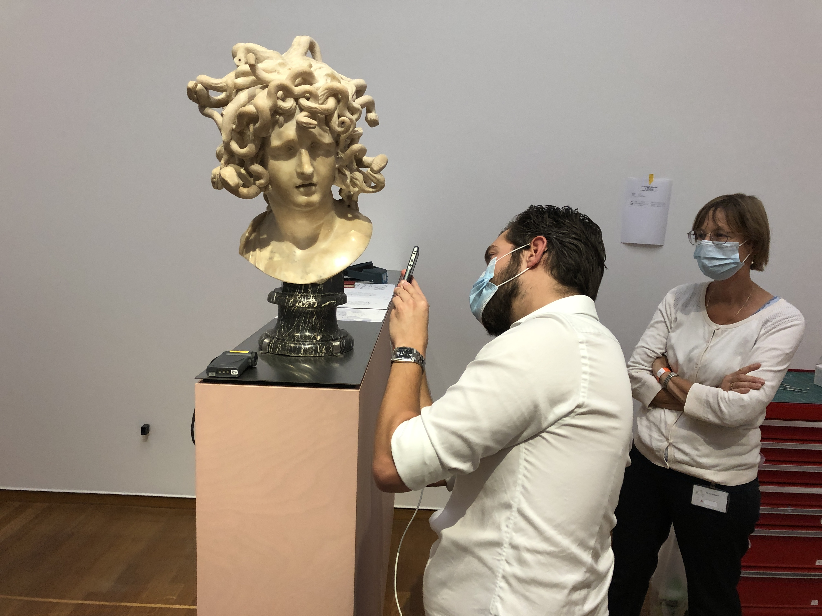
Section 8: Working with incoming couriers
Image credit: Wendela Brouwer
Notes:
When thinking about couriering, it is also important for us to ensure that any couriers we receive as a hosting venue are treated well, and leave with the impression that the museum is professional, collegiate and capable.
It is essential to ensure that there is a clear and common understanding of what the courier’s expectations and requirements are, and how you will meet these. The registrar team will be working with the lending institution to establish and communicate their requirements and make preparations in advance, however it is helpful for the whole team to have a shared understanding of how to prepare for a lending organisation’s courier:
• Communicate with the registrar in advance to find out who is coming, and what their remit will be. Do they have a particular reason for being the courier (is the work fragile, or does it require specialist knowledge to install), and do they bring a particular skill set (conservator, art handler, curator)?
• Will they want to see the case closed, or if a wall-hung work, are there works hanging adjacent to their loan items that need to be installed in advance?
• Do you have a clear understanding of the lender’s requirements for physical installation? Will they bring fittings and mounts, or is your team providing these? Will they want to be the only person to handle the loan, or will they take a more supervisory role and require your team to unpack and install?
• Does the work require any security measures such as an alarm or physical barrier, that need to be in place before the courier can leave?
• Do you know who will provide the paperwork to receipt physical entry of the object, and document its condition? Has the lender provided a detailed written condition statement, and does this account for any additional components such as frames? If not, are you ready to compile your own condition report or do you have equipment to take supplementary images?
• Who needs to be in the space at the same time (are there multiple loans within a case meaning several couriers need to be co-ordinated, does a lighting technician need to be on hand, are there enough technicians to unpack and install the work), and who doesn’t need to be in the space (any other activities should be timed to avoid clashing with lender installation, if possible)?
• Ensure that the installation wall or case is ready, and that suitable equipment is nearby to aid smooth unpacking, condition checking and installation (such as a clean table, plastazote sheeting, movable lighting, gloves etc.).
• When the courier arrives, introduce yourself to them (including what your role is) so they feel welcome and understands your discipline / skills.
• Await the lending institution’s courier before moving or opening crates, unless they have given their express permission in advance for you to do so.
• Check before signing any lender paperwork such as receipts or condition reports, to ensure that these do not include any terms and conditions. If they simply document the activity, this is fine. If in doubt, refer to the registrar for guidance.
• Be clear on when breaks will take place, and communicate to everyone involved. Everyone needs to take a comfort break occasionally, and of course eat. Co-ordinate breaks to ensure that the courier is able to achieve install or take a rest when needed.
• Listen to any concerns raised by the courier, and work together to resolve these, making sure the registrar is aware if there are difficulties.
Remember that other institutions may have very different methods of doing something. This is one of the great benefits of working with lending couriers, but can also require adaptability to ensure that both parties can agree how to achieve installation.

Slide 46
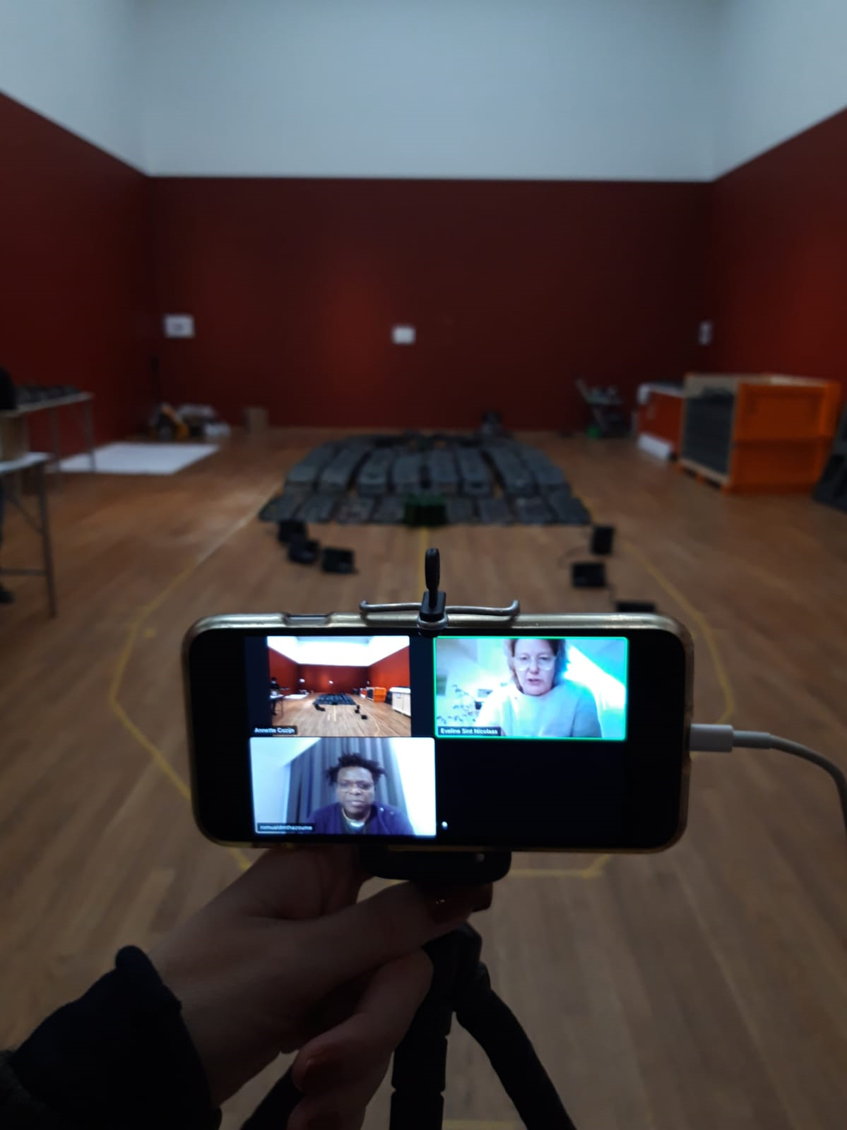
Section 9: Being a virtual courier
Image credit: Wendela Brouwer
Notes:
Sometimes there is a need for an element of ‘live’ supervision which does not require your physical presence and can be achieved via communication tools. This is a ‘virtual courier’ to travel with the object. Being able to use a ‘virtual’ courier can work to manage some types of risk, whilst reducing the impact on budgets and the environment. It is important to understand that this is not without impact and requires training and preparation for both the courier and the host venue.
This section will take the elements you have learned about live supervision and inform you what to expect from a virtual courier experience.

Slide 47
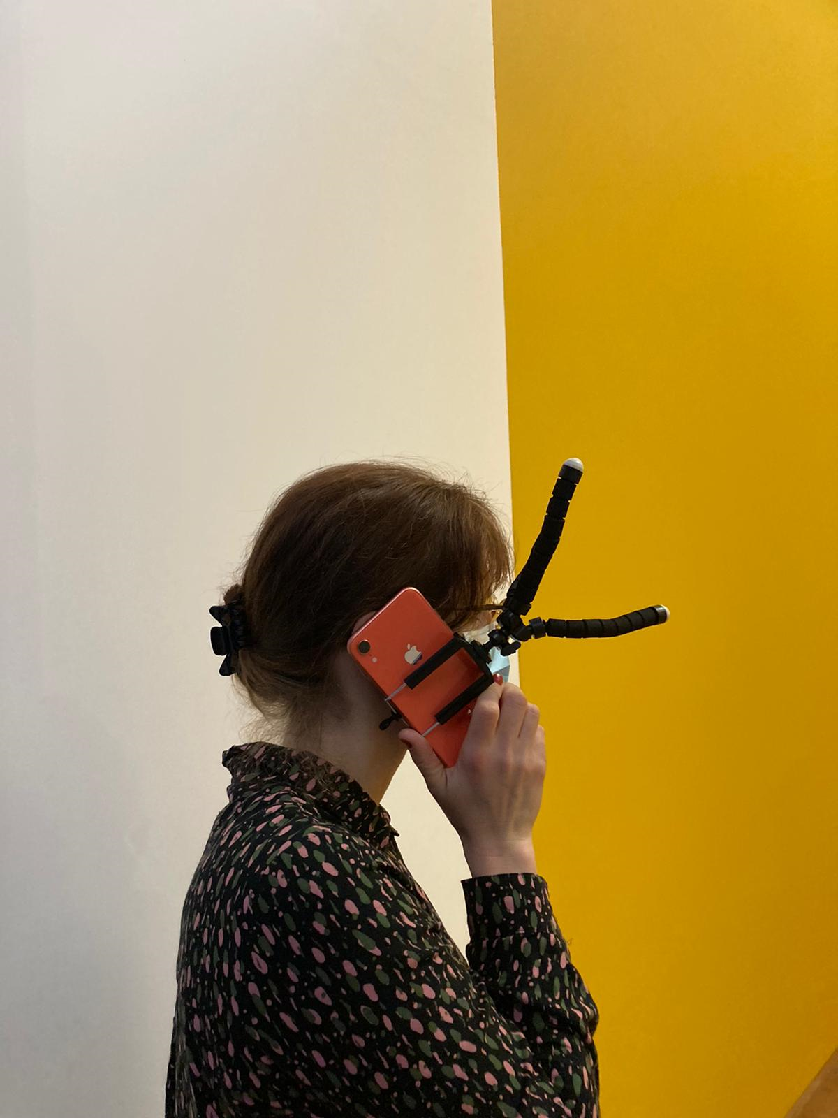
What is a virtual courier?
Image credit: Wendela Brouwer
Notes:
What is a virtual courier?
There are several different types of task that a virtual courier might be asked to participate in:
• Unloading / loading
• Unpacking / packing
• Condition checking
• Install / de-install
• Other (additional handling)
Ensure you understand which elements the virtual courier role needs to supervise and why (what are the risks you are seeking to mitigate).
Virtual couriering is usually achieved by live (real-time) supervision by video and audio link.
Ask the group to discuss what the main similarities and differences might be between live supervision and virtual couriering, then recap using the manual:
Differences:
Understanding the limitations of the technology. You may need to spend more time on the set up, and pausing of the virtual courier to ask the borrower to make clear the process as it is not as easy to ‘intervene’ successfully.
Less easy to pick up on surrounding activities, the atmosphere in the team etc – so ensuring good risk-management based approach is key.
Similarities:
As always, good preparation and communication are key.
You still need to ensure everyone has a good understanding of your role in the process, and agree how the borrower will carry out the tasks you are supervising.
You are still representing your organisation, so it is important to work collaboratively and professionally (be on time, ensure you have the right tools etc).

Slide 48
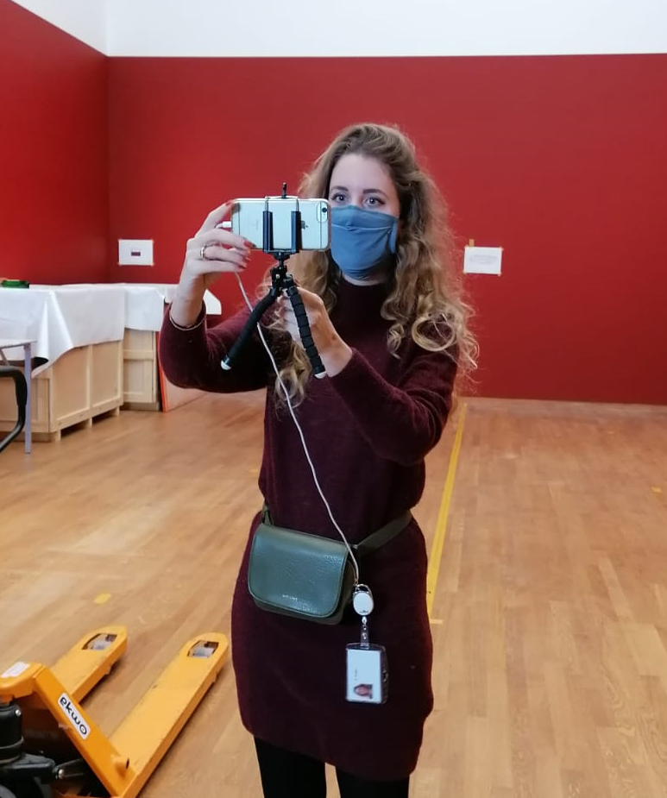
What are the technologies?
Image credit: Wendela Brouwer
Notes:
There are different devices and systems that might be used to achieve the virtual courier appointment.
Devices can range from mobile phones or portable electronic tablets, to laptops and cameras. Portable devices can help you to be mobile and get closer to the action, but this can also be a challenge (users may experience motion sickness as a result). Fixed devices can be set up to show a specific angle or view. This might be a challenge in terms of being able to see close details, or if action strays out of the field of vision.
Software systems range from encrypted Apps to organisation approved communication products like Skype, Microsoft Teams, Zoom, etc. It is important to understand whether the system being used is accessible to the virtual courier, and that they understand how to use it. If it is your first time using a particular system, requesting a demonstration test before the appointment will help ensure you are prepared. You could request to use your own organisation’s systems to achieve the appointment, but in which case you should offer test to the organising venue.
Virtual couriering is heavily reliant on wifi coverage both for borrower and lender. The organising registrar should have checked this in advance, but it is good to test systems before the appointment to identify if the connectivity will be an issue and find a solution.
Image quality can be a limiting factor, and a courier is unlikely to be able to pick up subtle changes in condition, for example lifting paint, cracks, or fine changes in surface condition which might be a cause for concern. It becomes even more important for the courier to know the object well, and to know what potential issues need to be highlighted in the appointment and whether the systems and devices are appropriate to achieve this.
Some appointments may require a hybrid solution with real-time supervision and then high-resolution images to be sent over by e-mail.

Slide 49
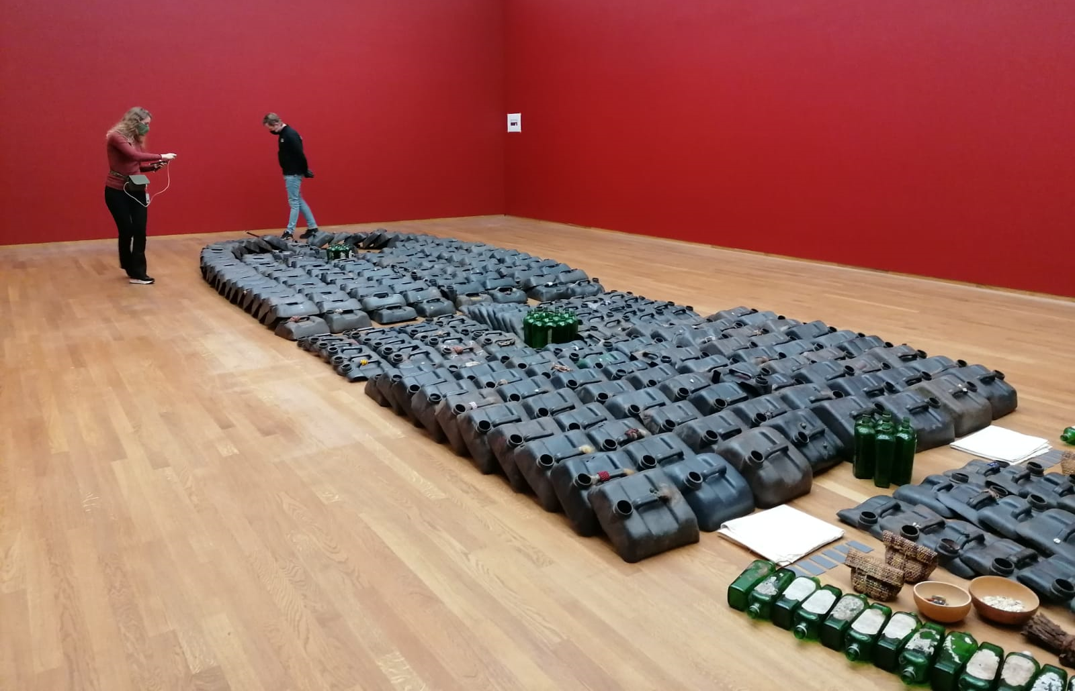
What to expect?
Image credit: Wendela Brouwer
Notes:
What to expect?
It can be a very different experience from a process where the courier is physically present. The courier may not have the same chance to establish a rapport with the person/people at the other end of the camera as they would in person. Factoring in time to ensure communications are working and everyone is comfortable will help.
As with a physical courier trip, there are preparations that will have taken place in advance: The lending registrar should be working with the venue to agree:
Type of tech and platform (high quality video and audio link)
Who will manage – usually a dedicated operator.
How to overcome any language issues – it can be more difficult to communicate virtually if there is not a common language.
What you (the courier) need to see, and who will work with you to facilitate this.
How the condition report will be signed if you are undertaking the remote condition check together.

Slide 50
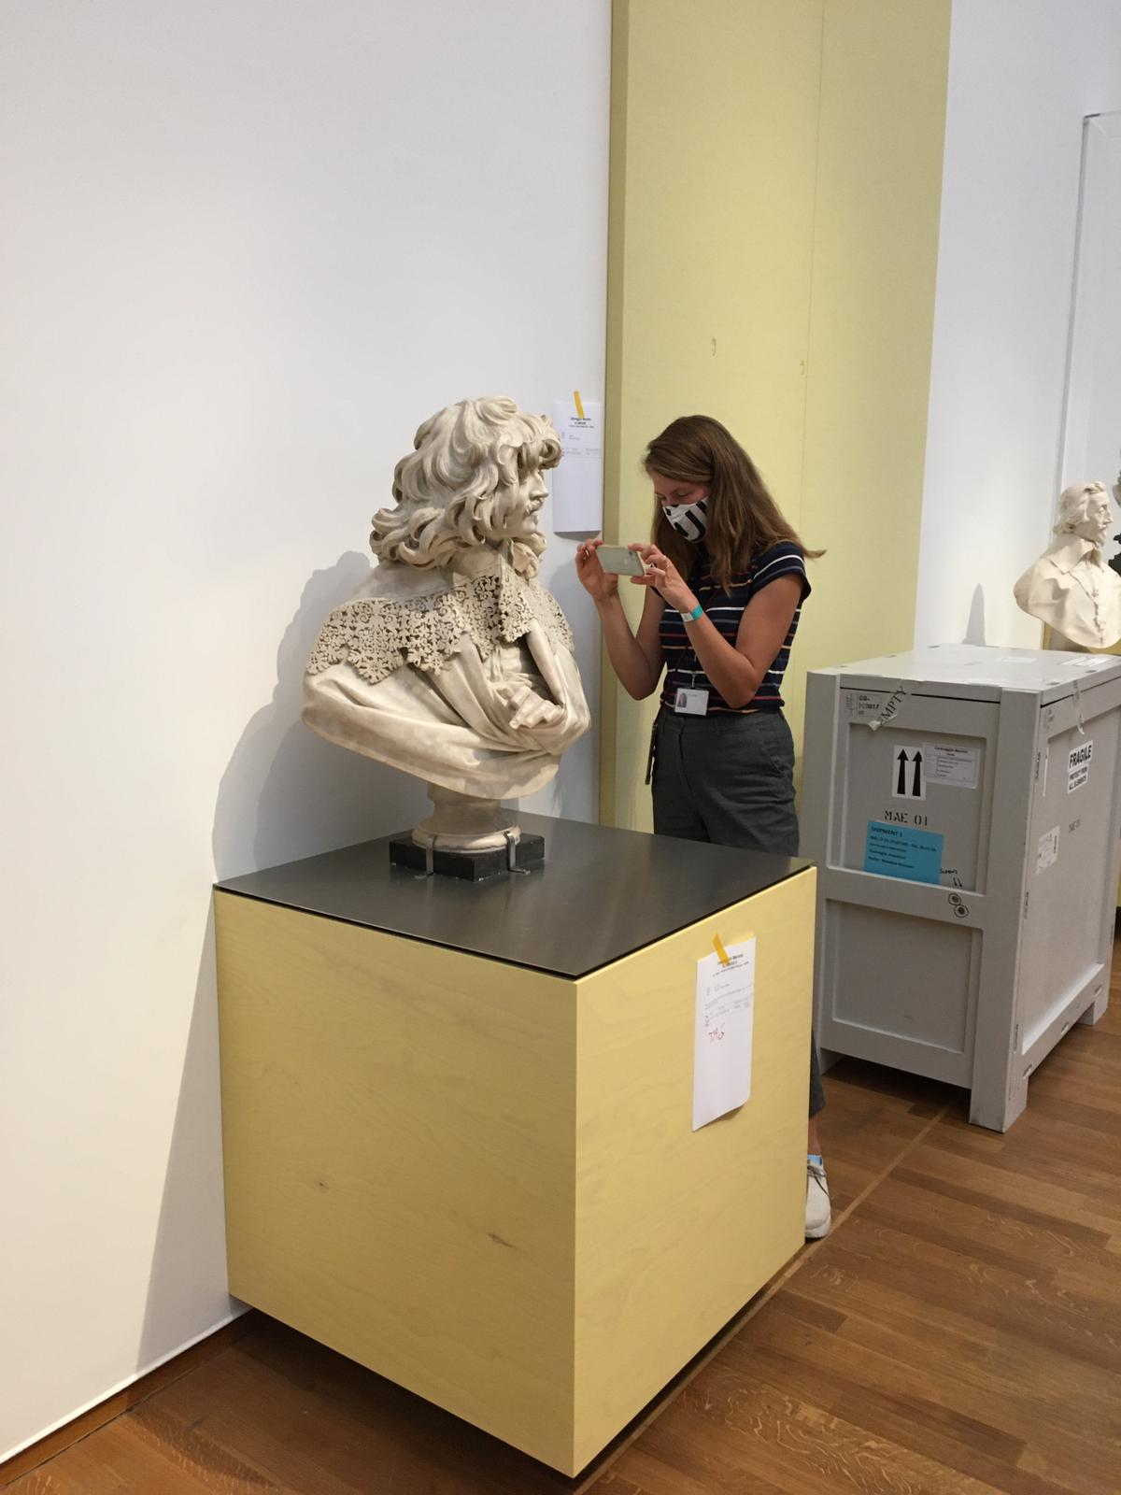
What should you do to prepare?
Image credit: Wendela Brouwer
Notes:
What should you do?
Ask the group what kinds of things they think they can do to be a good virtual courier, then use the manual to recap:
Be on time. (Be mindful of time zones and ensure you have factored in daylight savings time especially in countries where this can be variable).
Ensure you have good connectivity (as far as possible).
Minimise background noise for effective communication.
Take time to introduce yourself and establish a good rapport.
Think about camera angles – can you see everything you need?
Ensure you have a copy of the condition report at hand (and have reviewed it in advance) – and the borrower also has the same document. Usually digitally but can be a scan of a hard copy.
Begin the courier session by a brief survey of the immediate space and an introduction of the lender’s team.
Recap on expectations and roles if needed.
Review order of operations
If something is not working (sound is too poor or people keep blocking camera etc), ask for things to be adapted.
Be mindful of how you use the sidebar/chat function – this could help, but take care it doesn’t distract focus.
If issues arise that cannot be resolved in the appointment, discuss options and communicate clearly with the borrower – should they carry on without you or should they stop and rearrange the appointment once the issue is resolved?
Have a plan ready for what happens if the internet connection or signal fails? For consistency – your registrar might publish this in your loan agreement, or as a separate instruction.
Be patient and understand that, just like an in-person courier experience, the unexpected could happen and you will need to be flexible in your time commitments
Agreeing what is needed for a virtual courier trip is a good test to focus all parties on risk mitigation. It is good to check whether you need to see all process ‘live’, or whether it would be satisfactory for the borrower to record the process and send you the video or images later for confirmation.
Just like a physical courier trip it is important to understand the impact of any additional requests you make. For example asking for lots of images to be provided, or creating and sending videos, can be a significant burden to the borrower. Only ask for what it necessary and consider whether this is proportionate to the risk being managed.

Slide 51
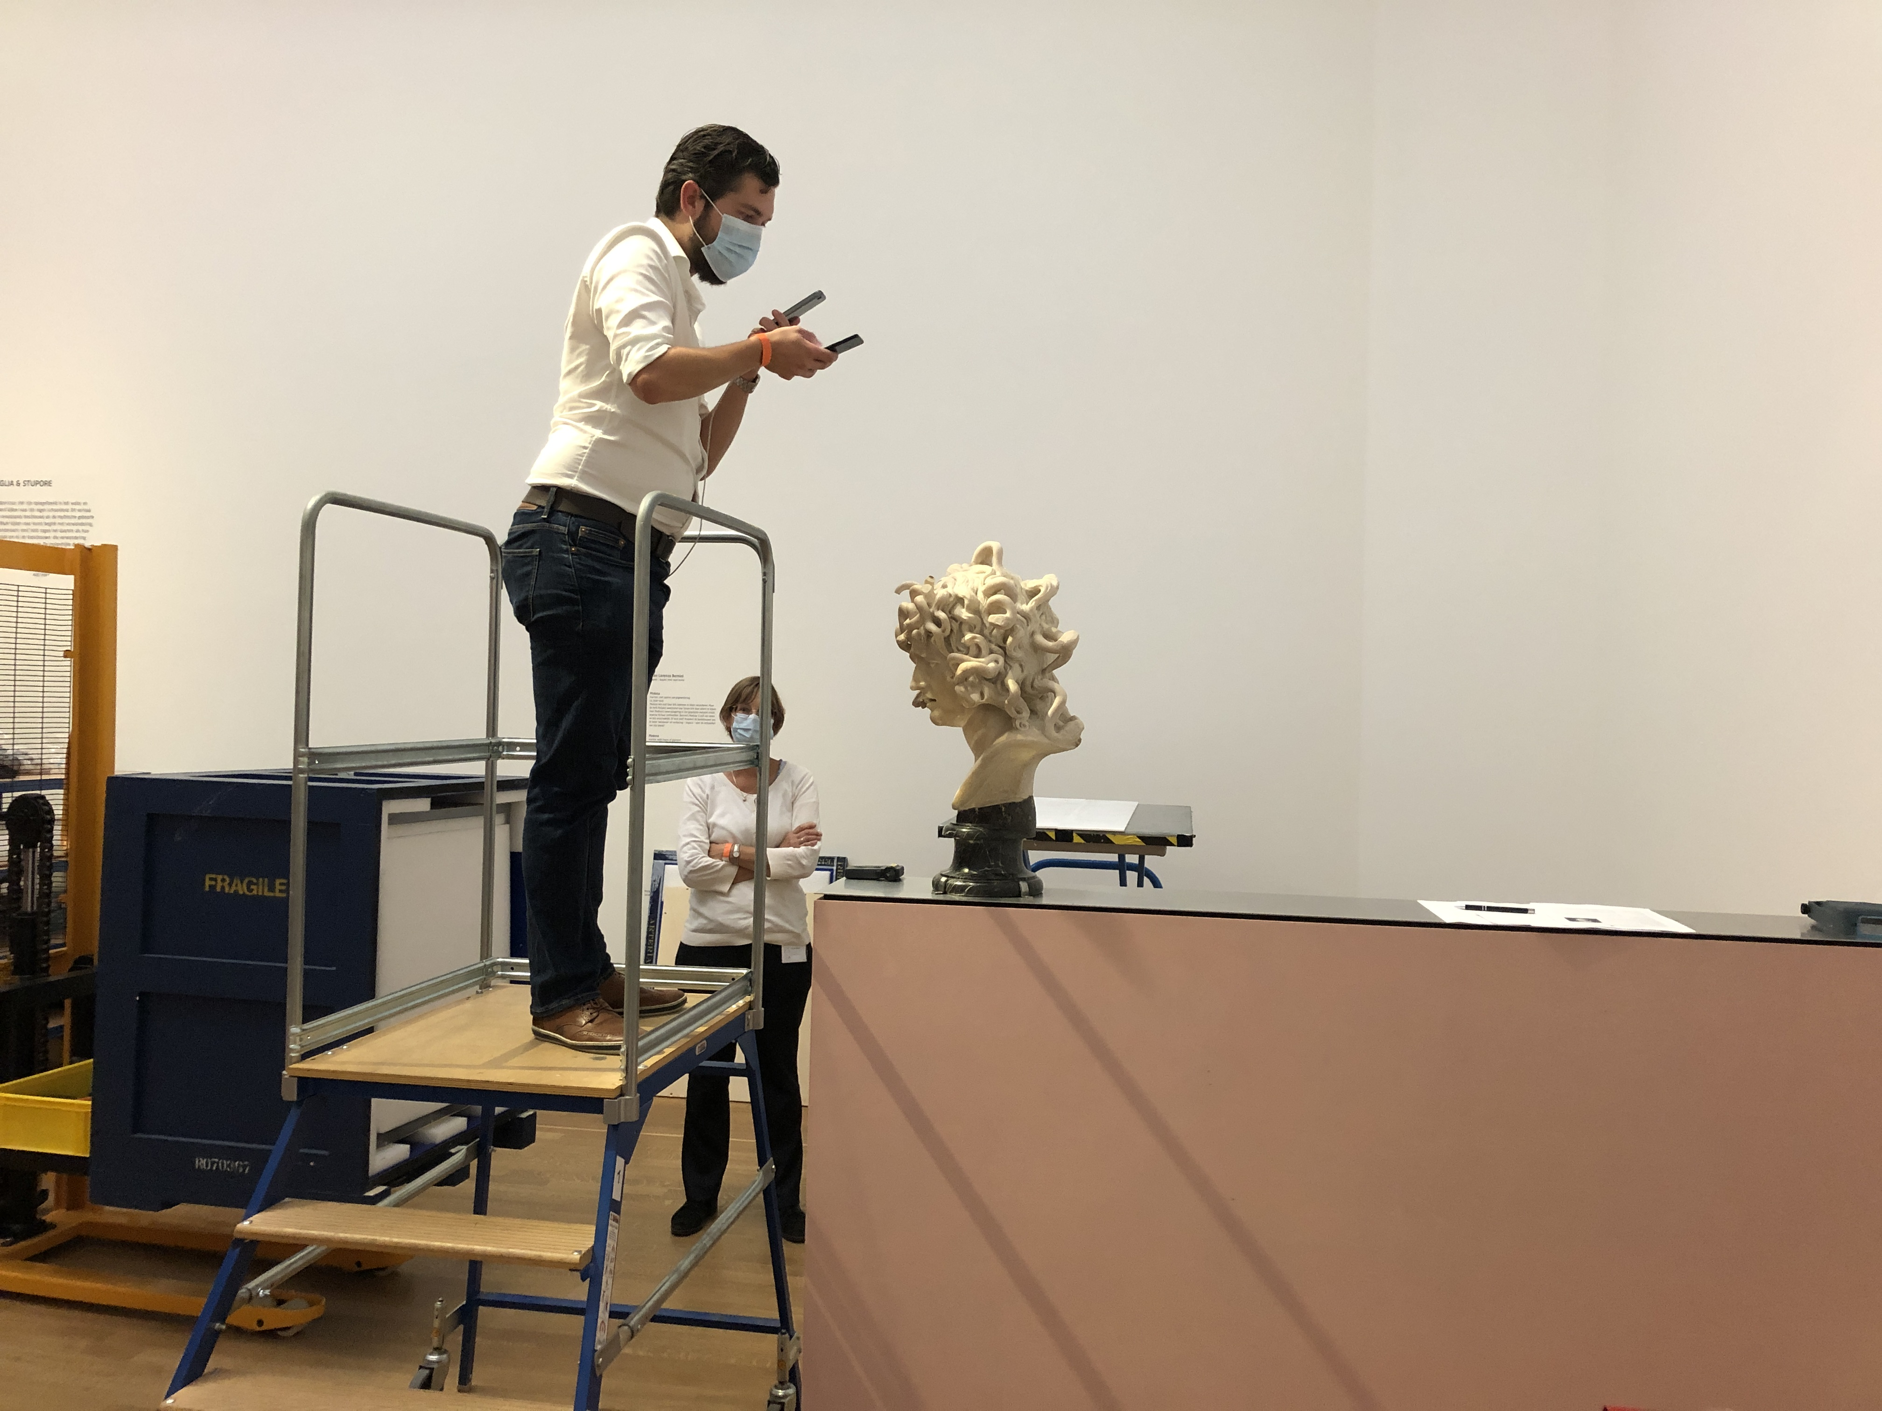
Hosting a virtual courier
Image credit: Wendela Brouwer
Notes:
Hosting a virtual courier
If you are hosting a virtual courier, we recommend you communicate early to ensure expectations of the appointment are aligned, and technologies are tested to avoid problems on the day. Having an alternative plan in case connectivity fails is also important.
Can you offer the lender a range of options that cover the risk they are seeking to mitigate and ensure good communications?
What should you do?
Confirm the virtual courier appointment time and all attendees in advance.
Confirm the platform is functional for both host and virtual courier.
Aim to provide two camera views if possible, one showing the workspace overall and one to focus on the object
Reduce ambient noise in the gallery
Confirm audio and video are functional prior to appointment time.
Once the virtual courier is present, make introductions and communicate expectations and order of operations prior to beginning work.
If your training focuses heavily on incoming courier support you may want to expand this section with discussion about what make a good virtual courier host.

Slide 52
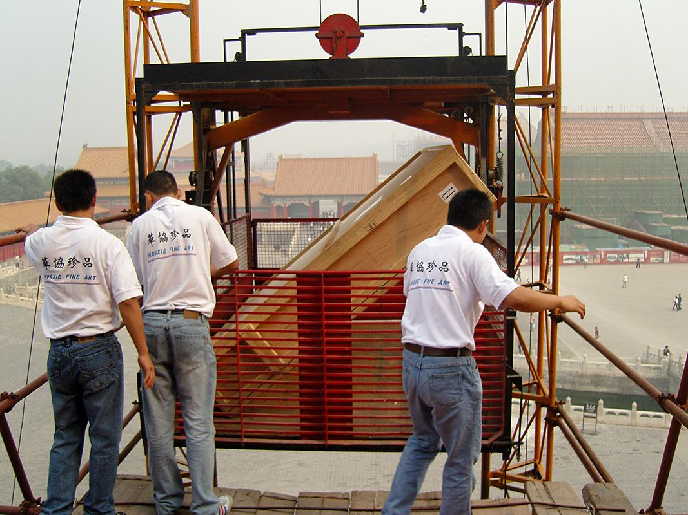
Section 10: Dealing with the unexpected
Credit: Fleur van Paassen
Notes:
Here refer to the scenarios provided (or is you have produced tailored scenarios – use your own). Ask the trainees to consider how they might respond. This can be done individually or in groups. We recommend small groups to encourage discussion and debate, and that you give each group a different scenario from the selection available. Allow time for discussion and then ask for feedback with the wider group. You can use this opportunity to re-inforce good practice (calling the registrar if challenges present themselves, asking for clarity, etc). After everyone has fed-back, you can distribute the ‘answers’ or ‘what really happened’ sections so that trainees can retain these as part of their training pack.

Slide 53

Section 11: Courier training to trained courier
Notes:
After receiving courier training, there may be a delay between the training and the opportunity to undertake a courier trip. There are different levels of complexity of courier trip, and we aim to introduce new couriers to the role in a staged manner, but it is not always feasible as this depends on the lending programme.
If this is the case, another way to develop your skills is to participate in an incoming exhibition and shadow visiting couriers and incoming loans. This is a good way to get used to the processes involved without cost to the institution.
All couriers can be provided with a courier questionnaire which guides the courier through the anticipated stages of the loan. This is a good tool to record your experience of the trip, and to keep on track with any requirements, and will be used as a basis for de-brief upon return. An template courier questionnaire is provided within this manual for reference.
Image free from Pixabay

Slide 54
Section 12: Courier dos and don’ts
Do know your object, including how it is packed, and how it can be handled and displayed.
Don’t make plans that conflict with your courier duties, and be cautious about making inflexible plans immediately afterwards (delays can be experienced).
Do communicate clearly, ask questions when you are unsure, and include others in your decision-making process.
Don’t forget to call base if there is a problem.
Do be organised and on time, ensuring you are fully briefed or have read the courier pack so you know what to expect.
Don’t be late (or very early) for your installation appointment.
Do look after yourself, ask for breaks when needed, and take rest when appropriate.
Don’t struggle on if you are ill, call home and let your registrar know so alternative arrangements can be made.
Do undertake your own research to help make your trip go smoothly.
Don’t miss your flight due to poor time-keeping or planning.
Do be proactive and try to think one step-ahead.
Don’t let anyone distract you from your role.
Do be prepared for anything, be flexible, pragmatic, and solution-focussed.
Don’t protect the object with your life!

Slide 55

Section 13: Courier Essentials
Notes:
Ask the trainees, either individually or in groups, to come up with a list of skills and attributes that a courier should have. Ask them to capture these, or capture responses of the group as a whole. Please share this capture with the Courier Training Framework team, via the contact details provided, along with any image of the training taking place.

Slide 56
Training closes
Notes:
Optional end of session slide to close training.

